Slide 1
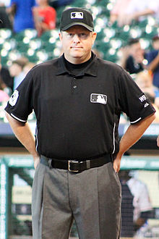
9.00 The Umpire
John watson

Slide 2
9.01 A Shall be responsible for the conduct of the game in accordance with
the official rules and for maintaining discipline and order
B Is the representative of the league and Little League Int’l
C Shall rule on any point not specifically covered
D Has authority to disqualify anyone from the playing field
F May order both teams to their dugouts and suspend play as league
officials deal with unruly spectators. Umpires can suspend the
balance of the game.

Slide 3
9.02 A A decision involving judgement is final. A manager may request
an appeal from you, but you do not have to ask for help. If have
no doubts, stay with your call.
B If a decision may be in conflict with the rules, the manager may appeal and ask that a correct ruling be made. (Keep a rule book handy)
C The Umpire making the decision may seek more information from
his partner

Slide 4
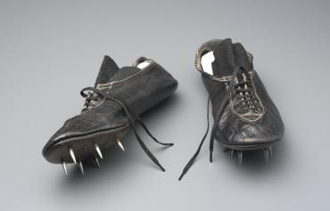
9.03 A If there is one umpire, You have complete jurisdiction
B Two or more umpires, designate an Umpire in Chief
In DSUA, Plate assignment is UIC
9.04 2 Umpires- joint responsibility
If 2 Umpires have different calls…….
(Don’t let this happen!)
9.05 Report ejections, injuries, and safety issues using the Incident
Report on our website, DSUA.org
9.06 No Metal Spikes

Slide 5
Umpire Expectations
* Properly dressed in uniform – Very Professional appearance
* Prompt and on time !
* Prepared, good knowledge of baseball rules
* Confident, poised, and able to take control
* be respectful, humble, and courteous while maintaining your authority!
* Hustle all the time – and alert for every play
* know where and how to get into the PROPER POSITION
* Decisive - make the tough call
* Clear in making calls – never timid or uncertain
* Always assertive – Never aggressive
* Unbiased and objective, respectful to the sport and its participants
* Consistent – always consistent
* Approachable and able to communicate effectively with respect
* Able to explain and clarify rules and rule interpretations

